Slide 1
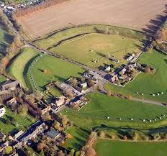
AVEBURY
One and only place

Slide 2
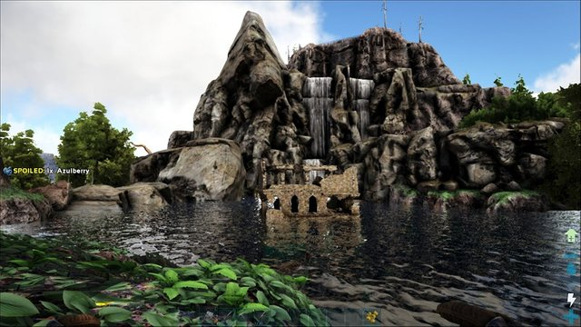
Information
How were the stones moved? They were probably pulled over by a raft of wooden logs and with the rock on top of the raft then put it in the water.

Slide 3
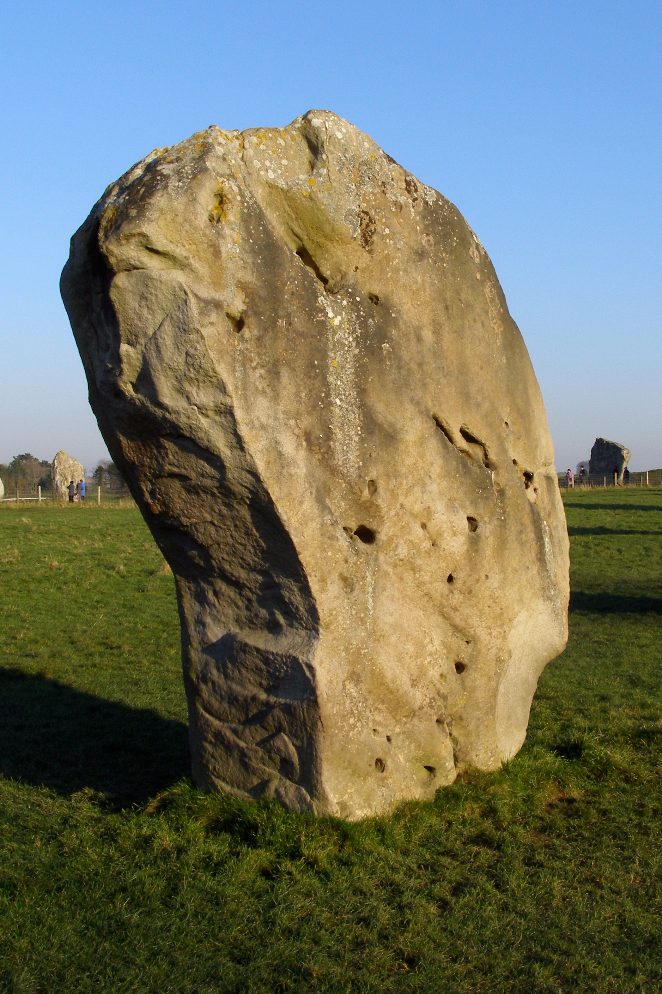
Barber stone picture

Slide 4
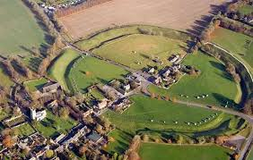

Slide 5
BY FRED AND CHLOE THE CREATORS

